Slide 1
Meta Data & Graph DB
Team 2 Week 9, March 08, 2023
Team Members:
Shanmukh Sanka
Rohit Anumolu
Deepika Kumar
Farzana Chowdhury Shampa

Slide 2



Agenda
Data Dictionary
Synthetic Data Generation
Graphs

Slide 3
Desired Data Dictionary
Attributes | Constraints | Description
Customer ID |  | Unique Identification
LOB Code | String of Char | Retail or Commercial
Product Name |  | Home loan, Personal loan, Real-estate loan, Mortgage, Car loan
Missed Payments |  | No. of payments missed by the customer.
Delinquent Days | 0/30/60/90 | Max delinquent of customer from all loans.
Probability of Default |  | Denotes the probability the customer will default. Loans would not be issued if this is high.
DTI | <50% | Debt to Income ratio
Primary credit score | 300-850 | Primary Credit Score of the customer. Fix it to be one of Equifax or Experian or TransUnion
PH_Status |  | Payment History status on missed payments
Credit_Age |  | Credit Age
CA_Status |  | Credit Age Status
Total_Credit |  | Total amount of credit depending on product
Hard_checks |  | Hard Checks
HC_Status |  | Credit check status
Credit_Usage |  | Percentage of credit used
Used_Credit |  | Total_Credit * Credit_Usage
Cu_Status |  | Current Usage Status
Available_Credit |  | Total_Credit - Used_Credit

Slide 4
Synthetic data generation
Assumptions
Attributes generated with rules | Constraints
Missed_payments | 60% : 0, 20% : 1-4, 10%: 5-10, 10%: 11-20
Total_Credit | Generated randomly with respect to product type
Used_Credit | Total_Credit * Credit_Usage
PH_Status, CA_Status, HC_Status, Cu_Status | Status created with respect to missedpayments, credit age, hard checks, credit usage following market research
Available_Credit | Total_Credit - Used_Credit
Delinquent Days | Calculated with respect to missed_payments. DD: 0 for mp 0, for mp 1-5 dd generated with respect to probabilities assigned.
Credit Score | Calculated from market research.
Probability of Default | Calculated with tree like model
Attributes generated randomly
Customer ID
LOB Code
Product Name
Credit_Age
Hard_checks
Credit_Usage
DTI

Slide 5
Synthetic data generation
Assumptions
Total credit generated with respect to product type. Used credit is generated with respect to a random generated percentage from 0 to 85.
Late payments generated with respect to probability values from some market-research. Most of the accounts generally have 0 late/missed payments and very less number as such. We emulated this by generating data with 60% for 0, 20% for 1-4, 10% for 5-10, 10% for 11-20.
Delinquency days is related to this late payments. Generated data for this with a similar strategy. Idea is, if late payments is 0, delinquency is 0, if it is below 5, some of these points have delinquency set as 0 for 60%, rest as 30. This kind of makes sure about the correlation and overall, the number of people with delinquency 0 is higher.

Slide 6
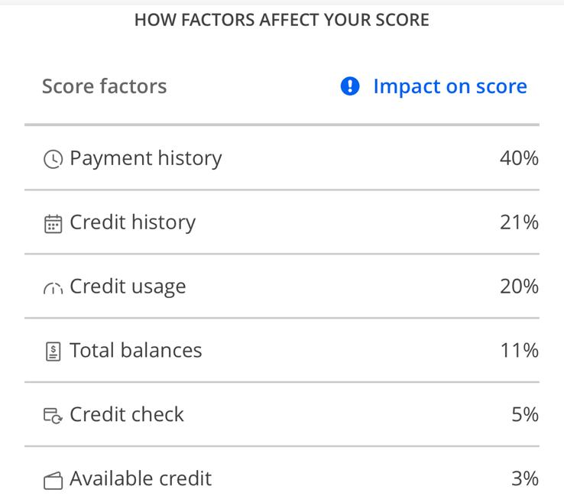
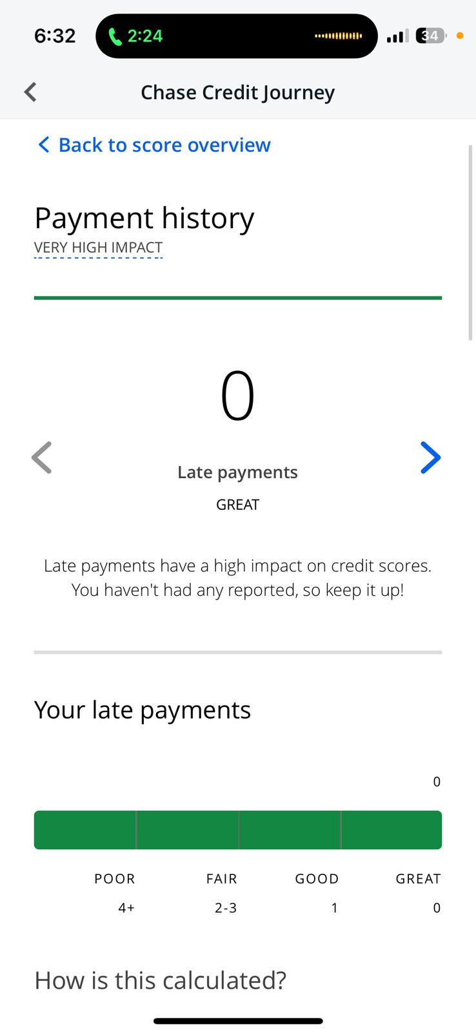
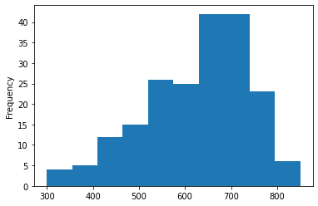
Synthetic data generation
1. Credit Score
Utilized weights for each of the feature beside in the image
Convert the values to bins and utilize the value with the weight to calculate the credit score
 | Late/Missed Payments | Credit History (months) | Credit Usage (%) | Credit Check
Great | 0 | 25+ | 0-9 | 0
Good | 1 | 8-24 | 10-30 | 1-2
Fair | 2-3 | 5-7 | 31-60 | 3-5
Poor | 4+ | 0-4 | 61+ | 6+
Generated data Distribution

Slide 7
Synthetic data generation
2. Probability of default
DATA
Credit score, delinquency days, debt-to-income ratio are utilized to calculate the get of default.
Initial idea to create a linear equation with different weights for different bins but got lost in picking the weights.
The idea is sort of create a decision tree (structure) to come up with a default value.
< 500
> 500
> 580
> 670
> 740
> 800
1
0
< 0.35
0.35 – 0.4
> 0.4
> 0.4
No
90
No
0, 30
60
90
0
90
Credit Score
0
0
1
0 or 1
0 or 1
Debt-to-income ratio
0
0 or 1
Delinquent days
Prob of Default

Slide 8
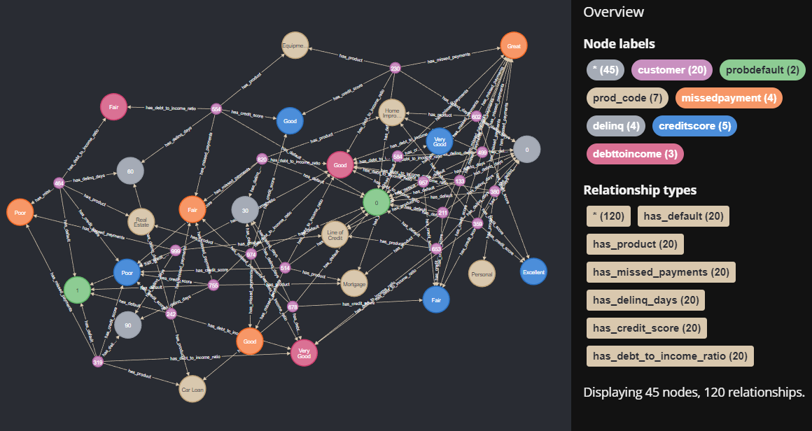

Slide 9
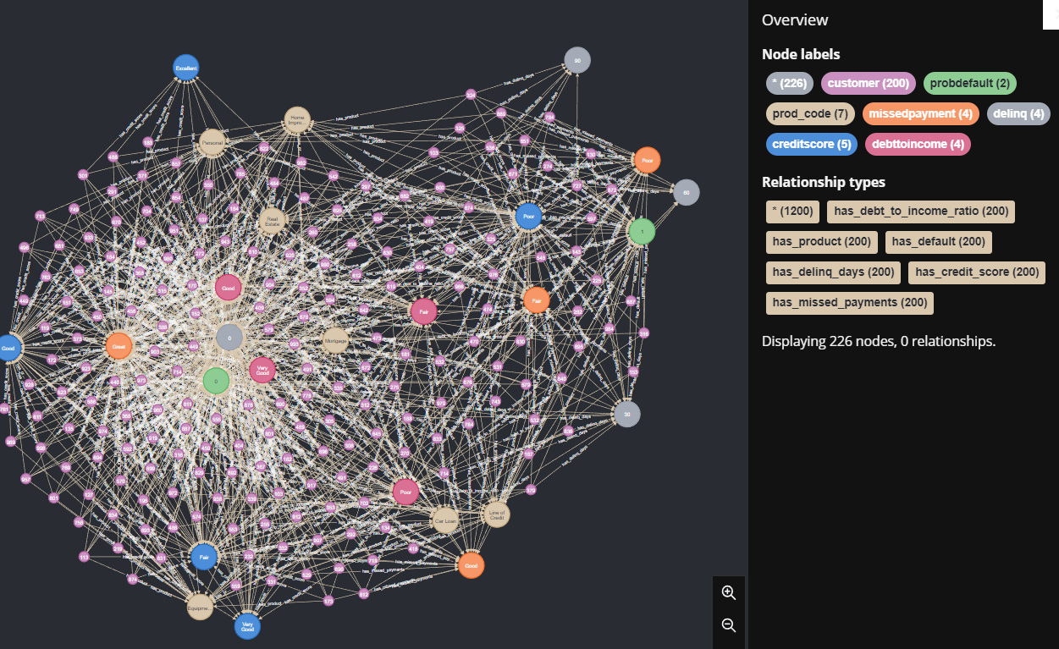

Slide 10
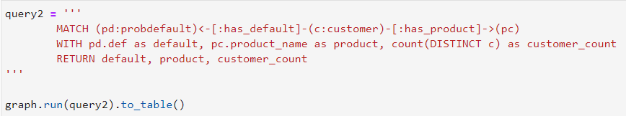
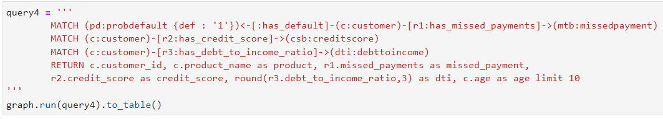
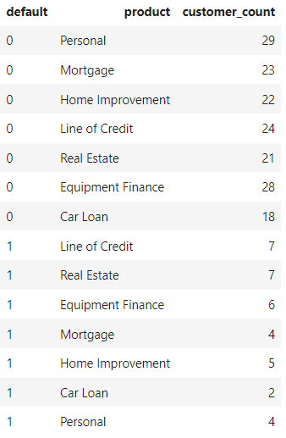
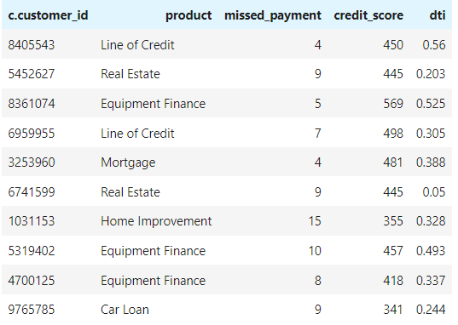
Insights from the graph

Slide 11
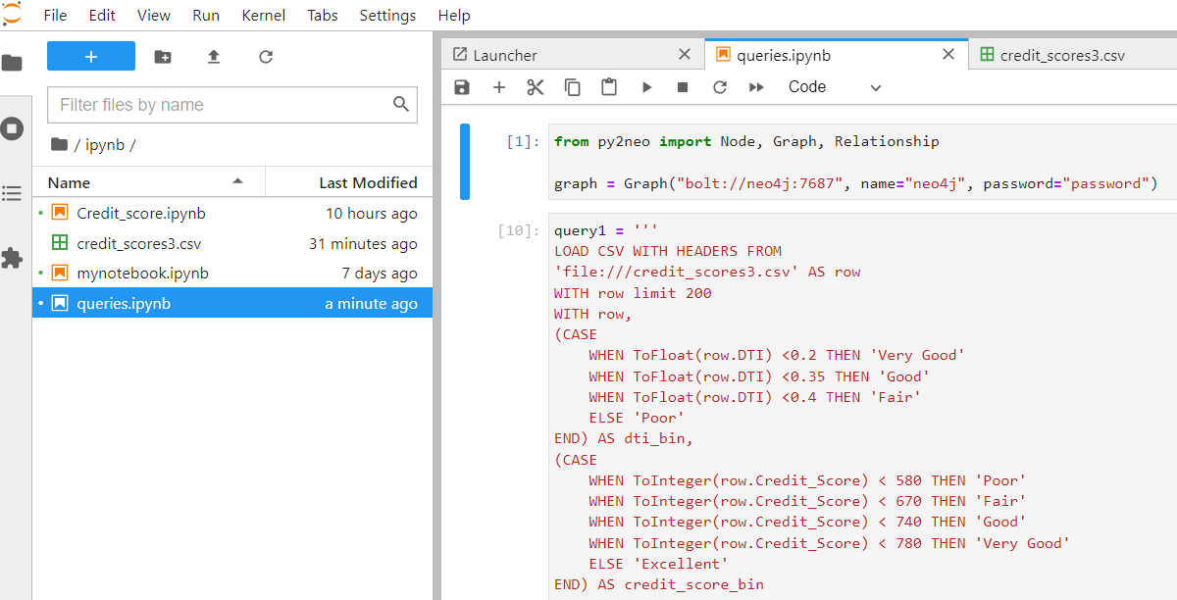
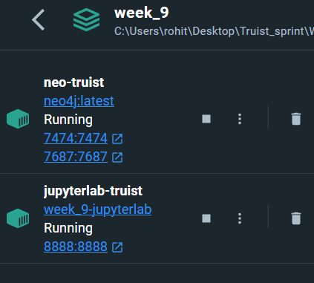
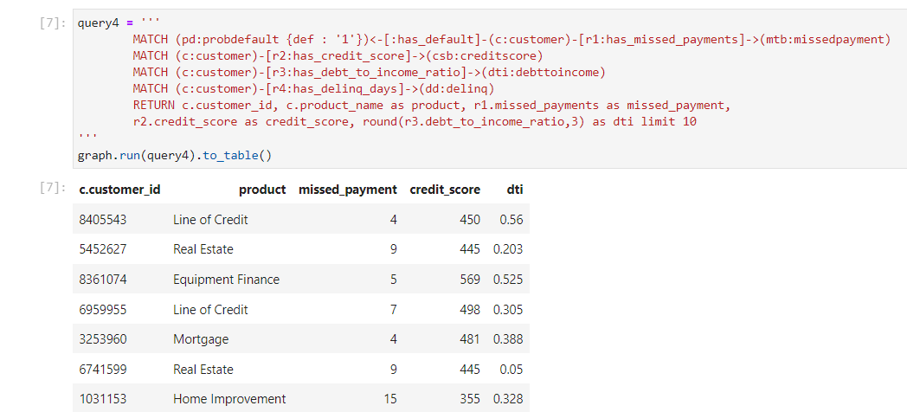
Docker
Docker Compose
Dockerfile

Slide 12
Questions ?

Slide 13
Thank you

